Slide 1
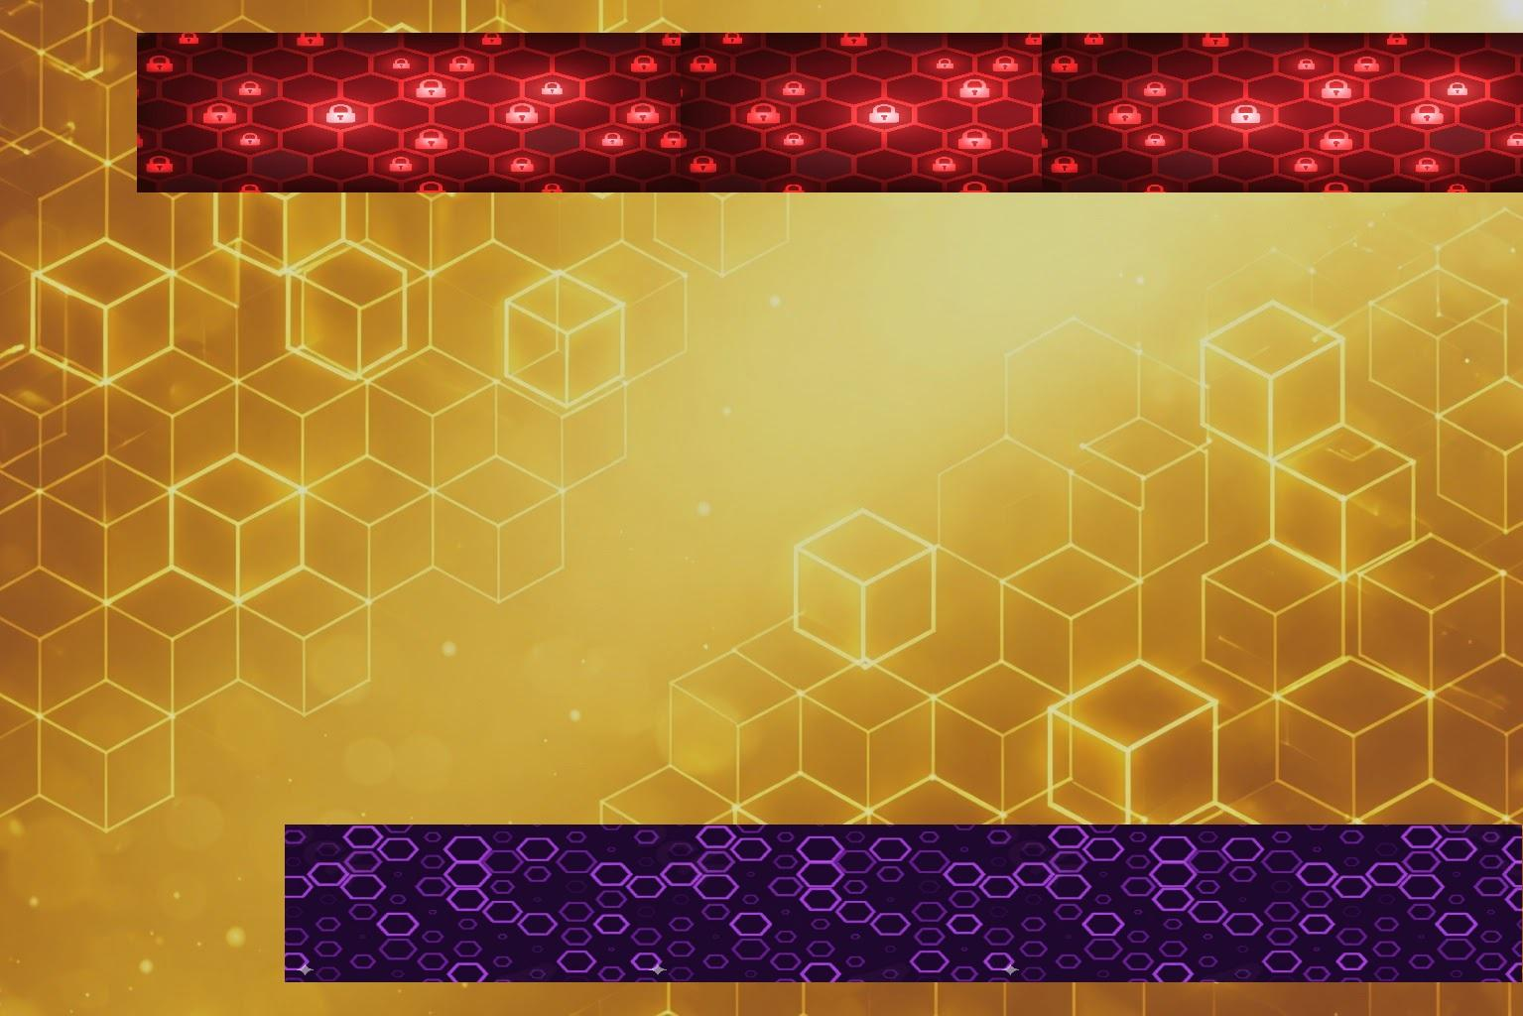


Executive Report:
Final Project
Francisco José Morante Lozada
4 Geeks Academy
Cybersecurity Bootcamp

Slide 2
Index
Phase 1, Forensic Autopsy:
Recognition
Suspicious Findings
Conclusions
Phase 2, Vulnerabilities and Exploitation:
Nmap, Gobuster, WpScan, SSH, FTP
Server Machine: Wordpress, MySQL, Journalctl
Exploiting another Vulnerability, Backdoor
Phase 3, Patching & Hardening
Fixing vulnerabilities
Hardening tools
Incident Response Plan and Conclusions

Slide 3

Phase 1:
Forensic
Autopsy
4 Geeks Academy
Cybersecurity Bootamp

Slide 4
Phase 1: Recognition
What is Autopsy Digital Forensic?
Why is it important for the Recognition?

Slide 5
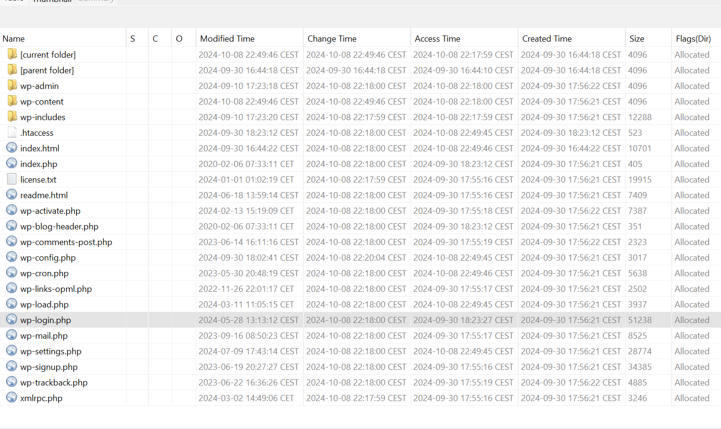
Phase 1: Wordpress

Slide 6
Phase 1: Suspicious Findings
UNKNOWN
SSH_ORIGINAL_COMMAND=
SSH_ORIGINAL_COMMAND
nologin
bash if on_ac_power; then
†††††
†††
Suspicious Login Attempts
Suspicious Code:
UNICODE inside important files.
Privileges Modification

Slide 7
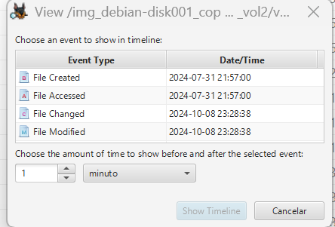
Phase 1: Conclusions

Slide 8

Phase 2:
Vulnerabilities
&
Exploitation

Slide 9
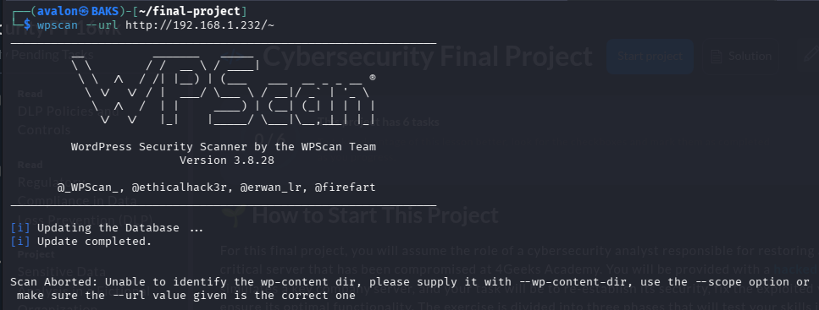
Phase 2: Exploitation Tools
Nmap
Gobuster
WpScan
SSH (Default)
FTP (Default)

Slide 10
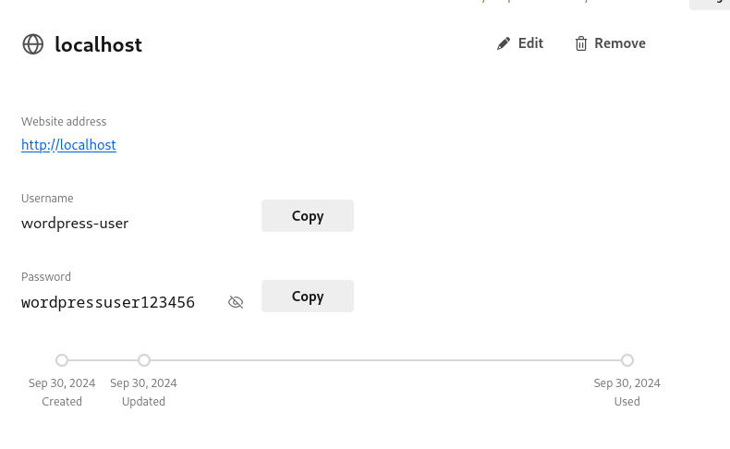
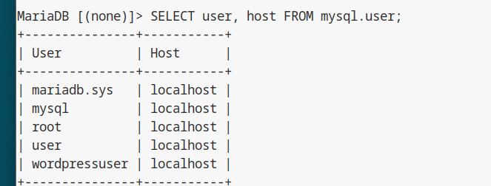
Phase 2: Server Machine
Wordpress
MySQL
MariaDB

Slide 11
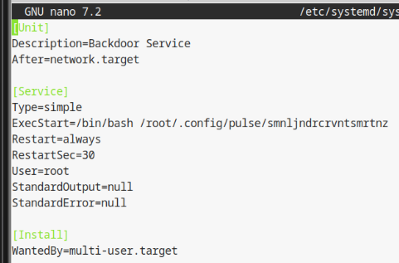
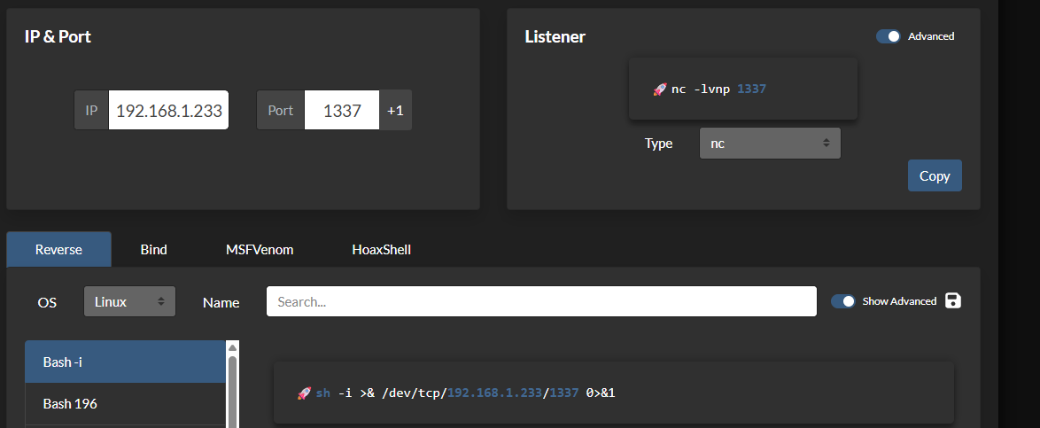
Phase 2: New Vulnerability
Backdoor Service / Reverse Shell
Creating the Script
https://www.revshells.com/
Creating a Service

Slide 12

Phase 3:
Patching
& Hardening

Slide 13
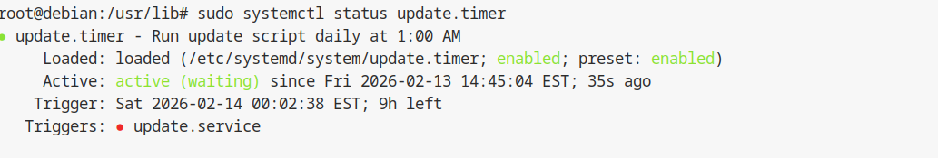
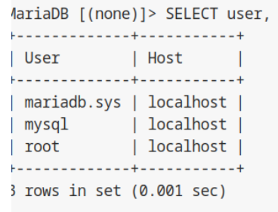
Phase 3: Fixing Vulnerabilities
Delete the backdoor
Updating the machine
Creating a new update service
Deleting or changing vulnerable Users

Slide 14
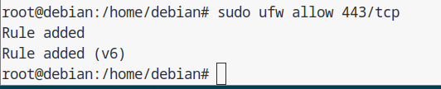
Phase 3: Hardening Tools
Installing UFW Uncomplicated Firewall
Wazuh (SIEM)
ClamAV
Antivirus Open Source
RKHunter
Root Kit Hunter
New Rules (UFW)
Blocking generic accesses
Blocking Root access
Opening Secure ports

Slide 15
Phase 3: Gobernance Impact
Conclusions
ISO Standards | 27001/27002/27003 | Market Exclusion
NIST | CSF 2.0, SP 800-61, 800-53, 800-30 | Market Exclusion
EU Regulations | GDPR, NIS2 DORA | €20~35 millions OR 4~7% Global Net income
US Regulations | HIPAA, CCPA, GLBA | $50k~100k per violation

Slide 16
Phase 3: Gobernance Impact
Conclusions
ISO Standards | 27001/27002/27003 | Market Exclusion
NIST | CSF 2.0, SP 800-61, 800-53, 800-30 | Market Exclusion
EU Regulations | GDPR, NIS2 DORA | €20~35 millions OR 4~7% Global Net income
US Regulations | HIPAA, CCPA, GLBA | $50k~100k per violation

